Slide 1
Machine Learning (and other techniques) In Analytics - Know our players better
- Su YANG

Slide 2
What problems can be addressed
Binary problems:
Is a player a one-time transaction type of player or multiple-times transaction type of player?
Can we predict if a player is leaving the game within next 2 weeks? (What policies to adopt to keep those players)
Classification problems :
Can we have 10 categories of monetizing players? How to label them?
Can we put players into 15 different spaces of distinct skillcap.
Regression problems :
For a player having played for X time and monetized Y time, can we predict how much money will he/she spend within next month?
Can we predict the amount of time a player is going to spend per day?

Slide 3
How does it work? (Regression)
Regression type of algorithm: It sets up a relationship manager that allows us to predict a certain metric predefined with certain inputs.
?
I am FPS
I am Rainbow six!
My name is colorful
Algorithm
I was born in 1998
?
I’m Mario Bros: syndicate
(Or am I?)
I have the most brothers
Europe
Victory is not my name
Relationship manager

Slide 4
How does it work? (classification)
Classification type of algorithm: builds a classifier that will be able to categorize new sets of inputs into predefined labels.
Rainbow six
First Person Shooter
?
Assassin’s Creed Unity
Action/ Adventure
?
Child of Light
Role Play Game
Algorithm
?
Adventure / RPG
Classifier
Watch Dogs 2
Chesslike Strategy
Might and Magic X
MMORPG (or am I?)
Next mysterious game

Slide 5
How can the analysis be used
For brands:
Using former games’ metrics to predict players behavior for newer generation of the game.
Ex: Data on AC Black Flag can be used for future AC titles in player-transaction behavior, thus enabling another tool to corroborate other forecasts.
Using former games’ metrics to change certain design aspect sin a purely monetization point of view, but can also lead to game play and mechanics change for retaining experienced players.
Ex: If players tend to monetize after a certain level in a game, or after performing a certain action in-game, we can analyze why and reproduce similar pattern.
Using former games to promote new marketing tools.
Ex: if players tend to monetize at a moment, and in-game message is intended for a game, maybe it is the right moment. If another moment a player sometimes monetize, another type of message and tailored promotion can be used.

Slide 6
How can the analysis be used
For new games:
Betas: especially for AAA games, more and more games require high quality betas and longer beta phases. Which means we possess players’ in-game behaviors before the game is released, but without monetization pattern. We can use existing data to both predict conversion rate to full game and conversion rate to monetize and even how much.
Competitive: (Rainbow Six) an intelligent match-making is possible with a ML algorithm, otherwise it is only a win-loss based knowledge which is a process without “memory”. Plus this allows us to balance in-game elements. (recognize favorable win conditions, are they working as intended? How to balance out the 39/61 win/loss ratio of the attackers in Rainbow Six?)
Social: the more players have friends playing a game, the more likely they are going to play. As a corollary, creating social bounds among players is important. Therefore, knowing how to recognize similar players (time, skill, monetization pattern and interests in-game) allow better friends suggestions tools or more discreetly a matching tool for specific multiplayer missions.

Slide 7
How can the analysis be used
For marketing and social space as a whole:
Community management: The right moment (in relation to other announcements of the group and of other companies) to communicate, what information (in-game gameplay, fan-made arts or fun facts?) to communicate, on what frequencies, through what channels (Facebook, LinkedIn, Twitter but also Twitch live stream and Q&As and Reddit AMAs), the latter metrics (number of tweets, followers and likes for instance) can lead to predict the importance of an announcement through that channel.
Information coverage: There are a lot of models (percolation theory, random walk theory, stepping stones etc…) that allow to explain the information “sale-through”, those analytics will lead to a more efficient way of communicating.
E-commerce: We need to think transactions within Ubisoft games as a whole space, and the longer a player stays inside Ubisoft space the more useful is ML-like analysis,

Slide 8
What the competition does (as of May 2015)
Riot : Insights (Bradon Hsiung Analytics, data science, research and data engineering. Since 2012), e-commerce (Mark Sottosanti, pricing policies and philosophies) and social (2.2 million Twitter followers and 12.5 million likes on Facebook.).
Blizzard: MapR (a distributed Hadoop service social used by Blizzard, they have small teams for specific games/purposes, the longest-standing one is led by Chaitanya Chemudugunta dating back to 2009), social(nearly 700K Twitter followers and 6 millions likes on Facebook for WoW alone)
Valve: Their data-approach is more pricing-oriented, which makes them more profitable on a per employee basis than let’s say likes of Google or Apple. Their head-economist is Yannis Varoufakis (a renowned economist) since 2012.
Zynga: Zynga Analytics (Daniel McCaffrey) It is the perfect example of data-driven gameplay optimizations company, their goal: maximize user conversions and revenues. (this is not the preferred way since I believe it can burn out users very quickly.)

Slide 9
But we can do better (At least we can start to do similar things)
Spark: What I would call the Hadoop and MapReduce 2.0. This is a distributed system that runs 100 faster (in terms of data fetching, data prepping and data analytics) than the currently used MapReduce technology and Hadoop storage system devised at Berkley since end of 2013, it is particularly useful when data collections become larger than can be handled. And it is at the edge of the technology, I don’t see anything close to it even in the research world.
Ex: Player gamestart tables which may contain billions of rows, the only fact of
fetching the data can take over days.
Scala/Python/R: Scala is the preferred language for function-oriented programming which enables working with spark and any person familiar with Java should be able to manipulate it with ease. The latter two are useful by themselves since they allow basic analytics (statistics, modelling) through build-in functions.
Creating a “Ubiverse”?: It is important to impose our brand as a whole instead of separated AAA brands, it enables fidelity cross-brands, helps to build a desired reputation, and maybe allows creation of inter-titles currency. Key words here: Ubi-economy space and a Ubisoft community. (instead of AC fans, FC fans, TF fans RS fans etc…)

Slide 10
Case study: AirMech (one time player and multiple player distinction)
Scope of the data: X360, all paying players (35,745 profiles), 26,932 used as training sets and 8813 as test sets. 20 parameters are used.
ProfileId | daysFrom20140718ToFirstPlayedDt | daysFrom20140718ToFirstPayDt | playDay | sessionsOnSecondPayDayOrLastPlayDay | totalSessionsSecondPayDayOrLastPlayDay | CountryShort | USDSecondPayDayOrLastPlayDay
00536378-1558-4839-95ff-52d3d26cd05d | 17 | 18 | 3 | 1 | 4 | GB | 0
0091023f-d6aa-431c-a9a6-530588cfdd28 | 100 | 100 | 5 | 1 | 10 | US | 0
00987483-9c8d-469b-aba5-419c5e1dcf76 | 21 | 22 | 2 | 3 | 5 | US | 9.99
0117fcc9-8731-4abd-8d25-2d52c9c00c05 | 64 | 114 | 8 | 1 | 11 | US | 0
016fa921-cf1a-4288-b605-29678613ded4 | 13 | 13 | 4 | 2 | 6 | US | 0
01876251-f9f8-488b-bcb6-c6177d9228d1 | 22 | 24 | 23 | 1 | 41 | US | 0
0188de9f-c4d9-4948-bd3a-fc8c9ba26059 | 21 | 22 | 3 | 1 | 8 | US | 0
02131168-f37e-4a40-80cd-dc9443a57c6d | 14 | 20 | 10 | 1 | 16 | US | 0
022f756e-7b01-439d-86a6-45982415219c | 47 | 49 | 2 | 1 | 2 | US | 4.99
0230ef1a-3750-4566-b0fa-4f72ea19c028 | 22 | 33 | 13 | 2 | 40 | US | 0
02396206-50f7-44be-8e8d-dfc4f0faa216 | 84 | 84 | 2 | 4 | 11 | US | 14.97
024dc8e0-1c2d-48c1-b9d8-4955d4193cc5 | 144 | 148 | 10 | 1 | 12 | US | 0

Slide 11
Case study: AirMech (one time player and multiple player distinction)
Results: 93.8% precision, 74.3% recall and fscore=0.83 -> Among the players I labeled multiple times monetizing player, 93.8% are really monetizing multiples times; 74.3% of multiple times paying players are correctly labeled. Fscore can be interpreted as a balanced view of the two formerly mentioned metrics.
 | Average TTP (hour) | Average persistent level | Average Fight Quit | Average totalUSDSecondPayDayOrLastPlayDay (Meaning it's on the second pay day of the player or the last pay days for one-time monetizing players) | Average played days
One time paying players (total) | 13.66 | 11.32 | 11.49 | 12.14 | 12.37
Multiple times paying players (toal) | 19.75 | 14.24 | 17.72 | 28.23 | 15.88
One time paying players (sample,actual) | 13.53 | 11.33 | 11.43 | 12.37 | 12.33
Multiple times paying players (sample, actual) | 19.55 | 14.17 | 17.15 | 28.57 | 15.76
One time paying players (sample, predicted) | 12.79 | 10.98 | 10.82 | 12.00 | 11.85
Multiple times paying players (sample, predicted) | 22.54 | 15.58 | 19.64 | 30.72 | 17.67
One time paying players percentage error | -5% | -3% | -5% | -3% | -4%
Multiple times paying players percentage error | 15% | 10% | 15% | 8% | 12%

Slide 12
Case study: AirMech (one time player and multiple player distinction)
Limits of the data: data set very small for big data; the data set is slightly skewed (there are very few players having monetized multiple times, here 8169 or 22.8% of the database);
Limits with the method: the data hasn’t been processed so every parameters have same weight which shouldn’t happen if we have insights over the data set; as a corollary, some parameters are too close to transaction behaviors, so their influences need to be leveraged, since we want to use in-game behaviors only to predict players monetization pattern in this case.
How to utilize the results: Try to recognize one time paying players and use strategy to make them buy more.

Slide 13
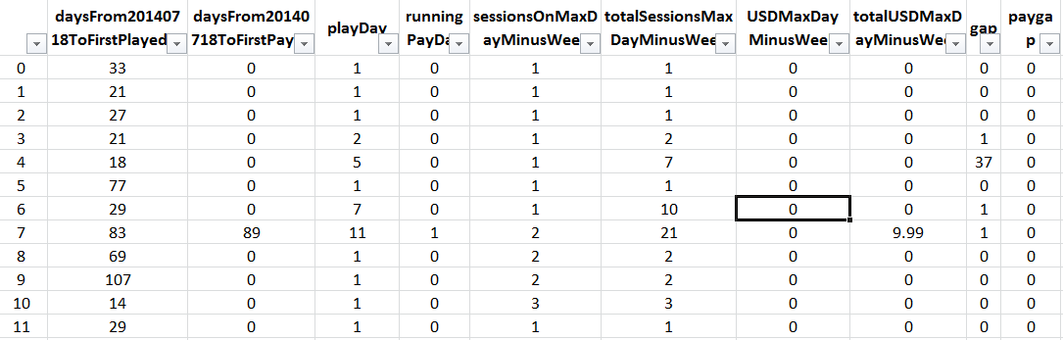
Case study: AirMech (Players classification)
Scope of the data: X360, a sample of players (100K profiles). 20 parameters are used.

Slide 14
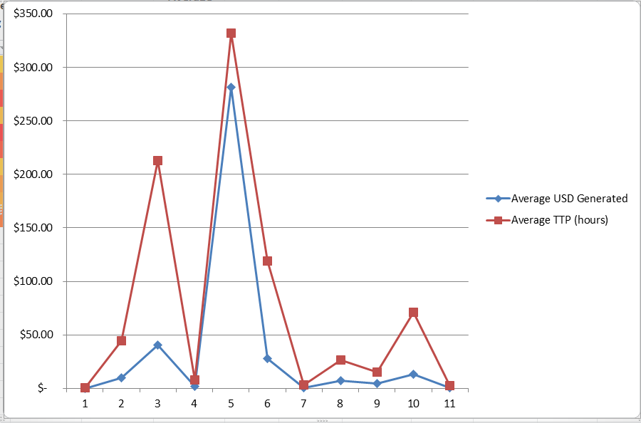
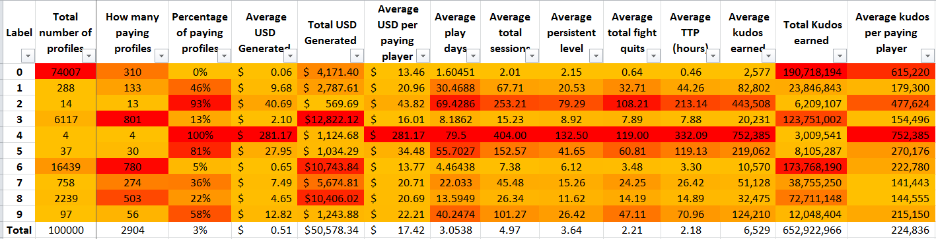
Case study: AirMech (Players classification)
Results: 10 categories. We can observe
some correlations, but also to see if certain
categories are monetizing “better” with
regards to other metrics, here I would
say 5s are monetizing well so we should
Reward, the 3s spend a lot of times playing,
thus needs more marketing attention.

Slide 15
Case study: AirMech (Players classification)
Limits of the data: It is still small, ideally we want to process over 1 million data points at least (it is called big data for a reason). Some parameters are too connected here to be considered independent, I’m merely analysing over a small pool of factors.
Limits with the method: This is an experimental study that doesn’t stress very specifically on the objective, do we need a monetizing profiling? Do we need player game-play profiling? Or do we evaluate the “strength” of a player?
How to utilize the results: it is a great promotional tools to display the different categories of players… It can be used to make tailored contents/marketing.

Slide 16
Conclusion
Via Machine Learning techniques, we can improve our business in ways we couldn’t before:
Improve conversions and retention rates by pinpointing soon-to-leave players. An estimate of retention rate via marketing tools, the generated revenue by the player and the precision of the algorithm, will yield the perfect individual marketing zone (why not making things free or even giving money if in a grand-scale, it will bring in revenues) and thus increase the revenue per player and per game.
Improve match-making: I mention this only because of Rainbow Six. Because ML takes into account the players’ behaviors instead of the memory-free process of the usual ELO system.
Improve e-commerce: a players' purchasing pattern can allow individual-tailored promotions and an aggregated study will yield the right frequency and content of mass promotions.
Improve the ways community is managed: analyzing Tweeter feeds, Facebook views, Reddit reactions, Twich streams and forum popular subjects are key to understand what information to put on the Internet space and when.
Etc…

